Slide 1
Student Details
Name : Paras Rupani
Email ID : parasmrupani@gmail.com
Registration ID : STU64af5feab65901689214954
College Name : Aurora’s Degree and PG College
College State : Telangana
Internship Domain : ARTIFICIAL INTELLIGENCE &
MACHINE LEARNING
Start Date - End Date : 15/08/2023 - 30/09/2023

Slide 2
Sentiment analysis of restaurant review
PROBLEM STATEMENT:
Determine the sentiment of restaurant reviews.
Customers provide various types of feedback after dining.
Reviews can either be positive or negative.
Predict the percentage of positive reviews in the entire dataset.

Slide 3
AGENDA
This project analyzes restaurant reviews to assess their sentiment and help individuals with dining choices, measure customer feedback, and offer insights for restaurant enhancement.
presentation covers:
Project Overview
Solutions & Value Proposition
Machine Learning Models
Results Presentation

Slide 4
PROJECT OVERVIEW
Approach:
Working on the dataset provided to us.
Providing restaurants with insights derived from customer feedback.
Dataset contains 1000 reviews in TSV format (text and binary labels)
Implemented in Google Colab using Python.
Significance:
Enhancing restaurant performance and customer satisfaction.
Empowering diners to make informed restaurant choices.

Slide 5
END USERS
Various stakeholders in the industry reap the benefits:
Owners/Managers: Assess customer satisfaction, identify improvements.
Chefs: Gather feedback to refine dishes.
Marketing: Monitor online reputation and craft strategies.
Customer Service: Identify issues and improve relationships.
Reviewers: Enhance assessments with data-driven insights.

Slide 6
SOLUTION AND VALUE PROPOSITION
Our project employs advanced NLP techniques and machine learning to classify sentiments in restaurant reviews accurately, ensuring restaurant owners receive dependable feedback. It offers value to:
Restaurant Owners and Managers:
Actionable insights, improved satisfaction and increased revenue.
Customers:
Enhanced dining, reliable reviews, informed choices.

Slide 7
customize the project To make it Unique
Data Preparation: Loaded dataset, inspected structure, checked for missing values.
Data Exploration: Examined data distribution and sample records.
Text Preprocessing: Lowercased text, removed punctuation, tokenized, removed stopwords, and performed lemmatization.
Feature Extraction: CountVectorizer converts text into numerical features.
Model Selection: Chose Naive Bayes and Logistic Regression for sentimen
analysis.

Slide 8
customize the project To make it Unique
Model Training and Evaluation:
Split data, trained models, evaluated accuracy, classification metrics.
Random Sampling:
Selected 25 random reviews for testing.
Saving Results:
Saved predictions and actual sentiments in a TSV file.
Data Visualization and Insights:
Explored data patterns and sentiment trends through visualization.

Slide 9
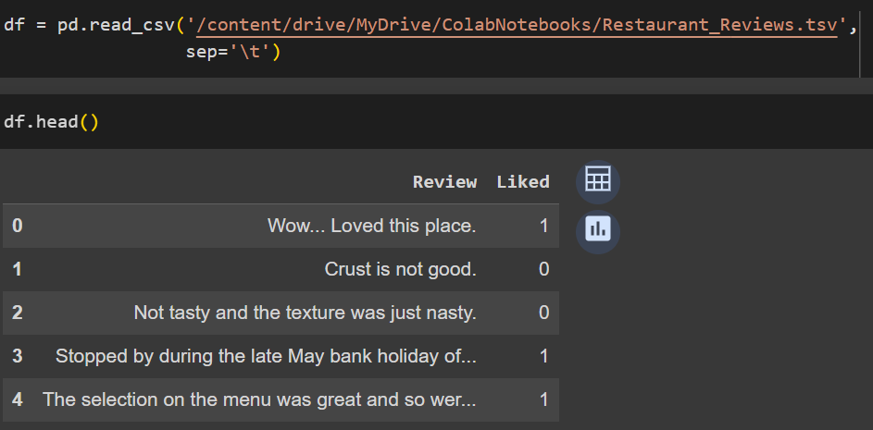
raw Data

Slide 10
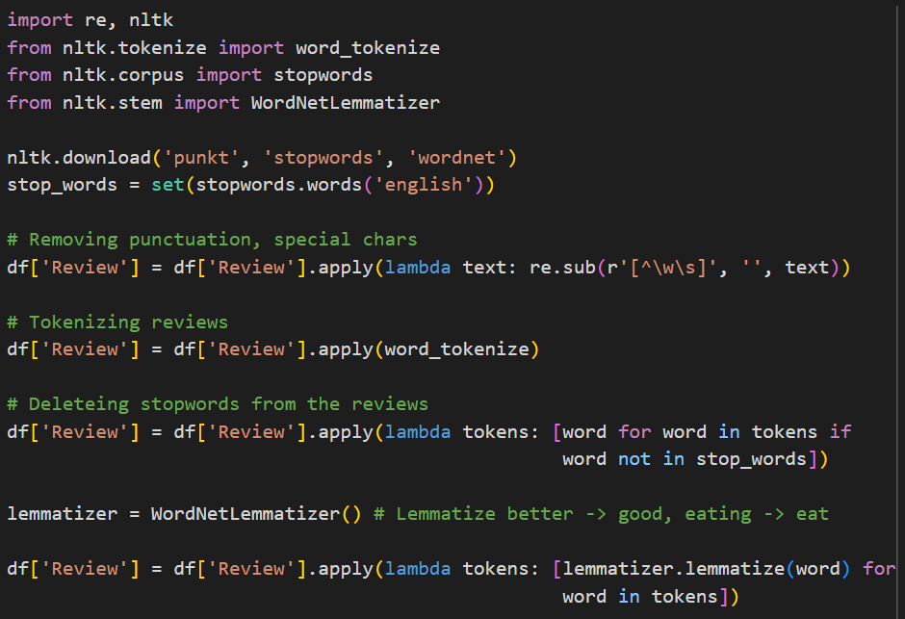
Formatting Data

Slide 11
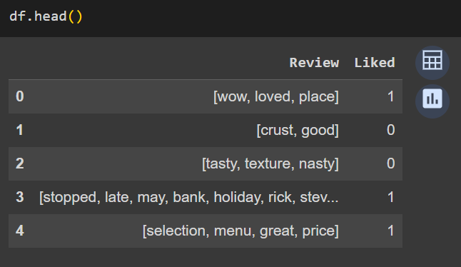
Formatting Output

Slide 12
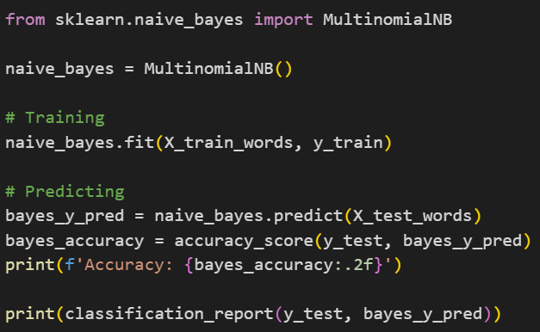
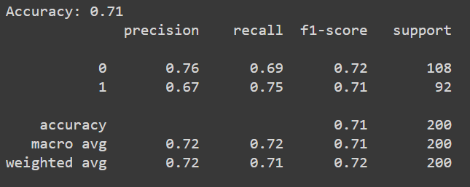
MODEL: Naive Bayes

Slide 13
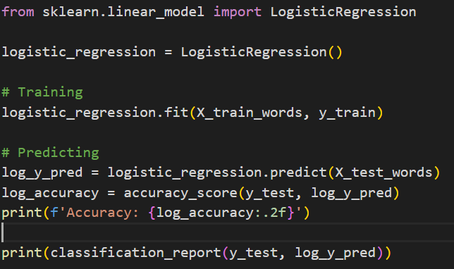
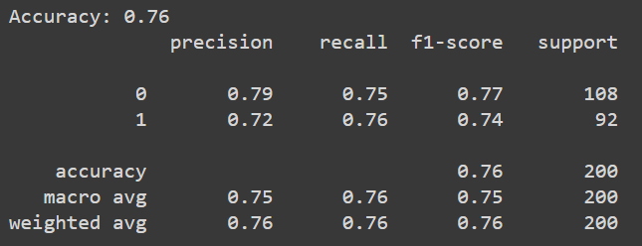
MODEL: Logistic Regression

Slide 14
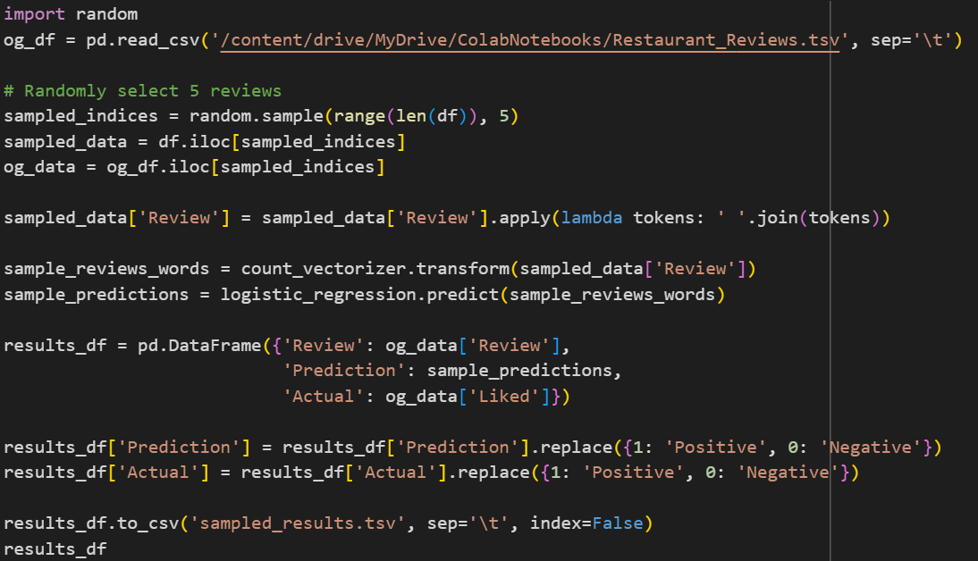
Randomly choosing elements for test

Slide 15
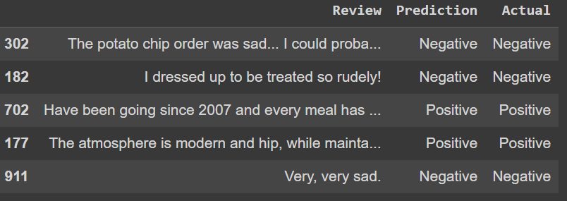
Output of Random Selection

Slide 16
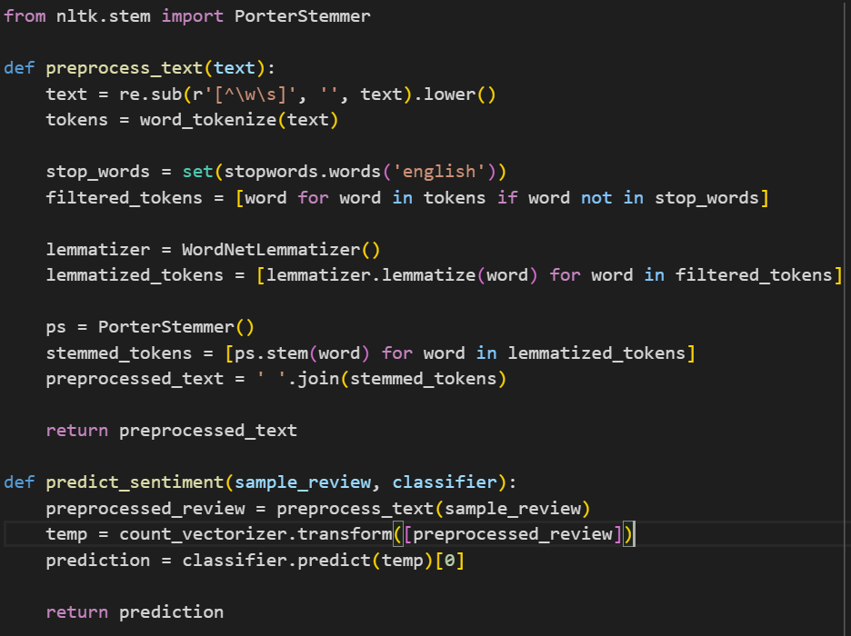
function which analyzes the sentiments

Slide 17
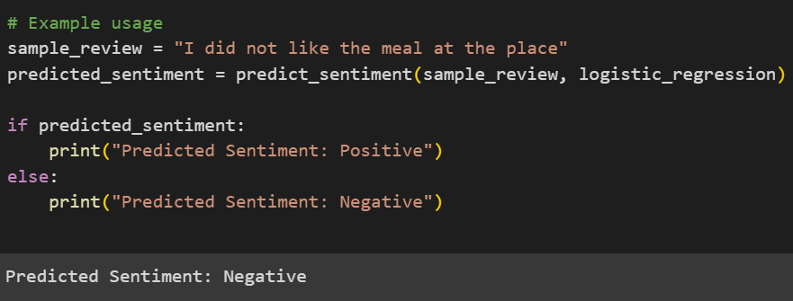
Function usage

Slide 18
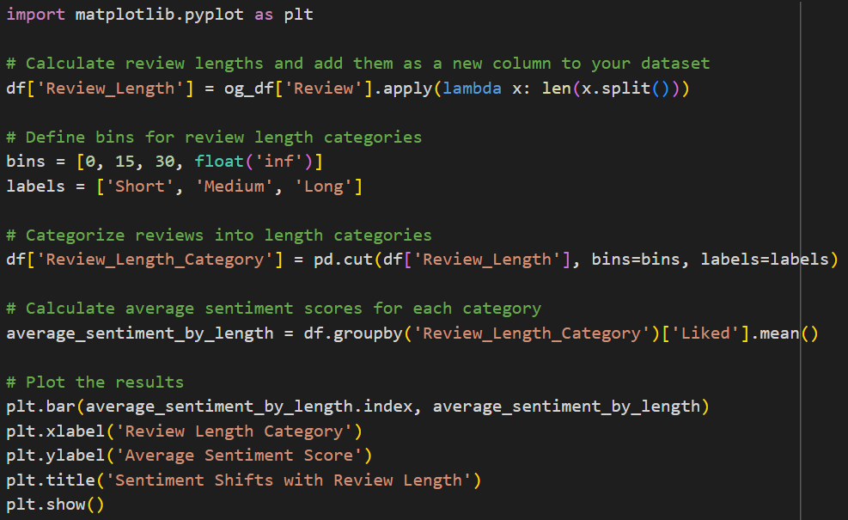
Visualizing sentiments based on length

Slide 19
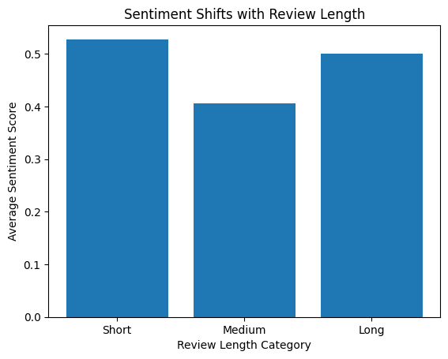
Visualizing sentiments based on length

Slide 20
Results
Naïve-Bayes model the accuracy achieved is 71%
Logistic Regression performs better with an accuracy of 76%
Shorter reviews are positive, as customers express their highlights.
Medium reviews strike a balance with mixed sentiments.
Longer reviews tend to have a mix of positive and negative feedback.

Slide 21
References
Google Collab
GitHub
Kaggle
IBM Skillsbuild
Edunet Foundation

Slide 22
THANK YOU!

